Slide 1


Data Types in Data Analytics

Slide 2
Attribute:
It can be seen as a data field that represents the characteristics or features of a data object.
For a customer, object attributes can be customer Id, address, etc.
It can be seen as a data field that represents the characteristics or features of a data object. For a customer, object attributes can be customer Id, address, etc.

Slide 3
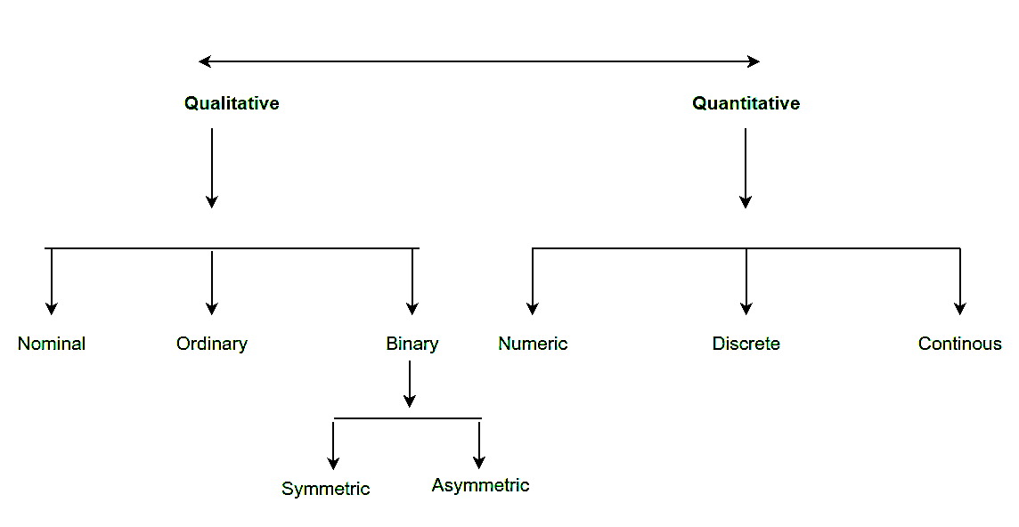
Type of attributes :
Qualitative (Nominal (N), Ordinal (O), Binary(B)).
Quantitative (Numeric, Discrete, Continuous)

Slide 4
Qualitative Attributes:
Nominal Attributes – related to names: The values of a Nominal attribute are names of things, some kind of symbols. Values of Nominal attributes represents some category or state and that’s why nominal attribute also referred as categorical attributes and there is no order (rank, position) among values of the nominal attribute.

Slide 5
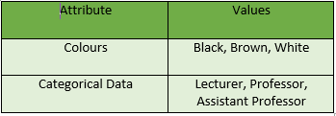

Slide 6
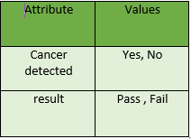

Binary Attributes: Binary data has only 2 values/states. For Example yes or no, affected or unaffected, true or false.
Symmetric: Both values are equally important (Gender).
Asymmetric: Both values are not equally important (Result).

Slide 7
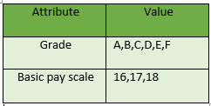
Ordinal Attributes : The Ordinal Attributes contains values that have a meaningful sequence or ranking(order) between them, but the magnitude between values is not actually known, the order of values that shows what is important but don’t indicate how important it is.

Slide 8
Quantitative Attributes:
1. Numeric: A numeric attribute is quantitative because, it is a measurable quantity, represented in integer or real values. Numerical attributes are of 2 types, interval, and ratio.
An interval-scaled attribute has values, whose differences are interpretable, but the numerical attributes do not have the correct reference point, or we can call zero points. Data can be added and subtracted at an interval scale but can not be multiplied or divided. Consider an example of temperature in degrees Centigrade. If a day’s temperature of one day is twice of the other day we cannot say that one day is twice as hot as another day.
A ratio-scaled attribute is a numeric attribute with a fix zero-point. If a measurement is ratio-scaled, we can say of a value as being a multiple (or ratio) of another value. The values are ordered, and we can also compute the difference between values, and the mean, median, mode, Quantile-range, and Five number summary can be given.

Slide 9
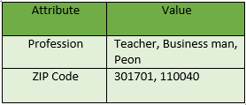
2. Discrete : Discrete data have finite values it can be numerical and can also be in categorical form. These attributes has finite or countably infinite set of values.

Slide 10
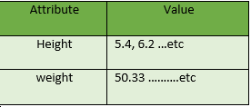
3. Continuous: Continuous data have an infinite no of states. Continuous data is of float type. There can be many values between 2 and 3.

Slide 11
Normal Distribution of data
In a normal distribution, data is symmetrically distributed with no skew. When plotted on a graph, the data follows a bell shape, with most values clustering around a central region and tapering off as they go further away from the center.
Normal distributions are also called Gaussian distributions or bell curves because of their shape.

Slide 12
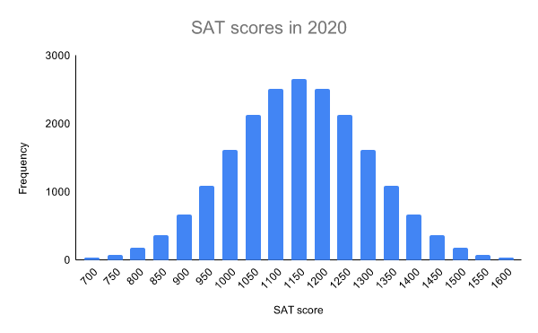

Slide 13
All kinds of variables in natural and social sciences are normally or approximately normally distributed. Height, birth weight, reading ability, job satisfaction, or SAT scores are just a few examples of such variables.
Because normally distributed variables are so common, many statistical tests are designed for normally distributed populations.
Understanding the properties of normal distributions means you can use inferential statistics to compare different groups and make estimates about populations using samples.

Slide 14
The properties of normal distributions
Normal distributions have key characteristics that are easy to spot in graphs:
The mean, median and mode are the same.
The distribution is symmetric about the mean—half the values fall below the mean and half above the mean.
The distribution can be described by two values: the mean and the standard deviation.

Slide 16
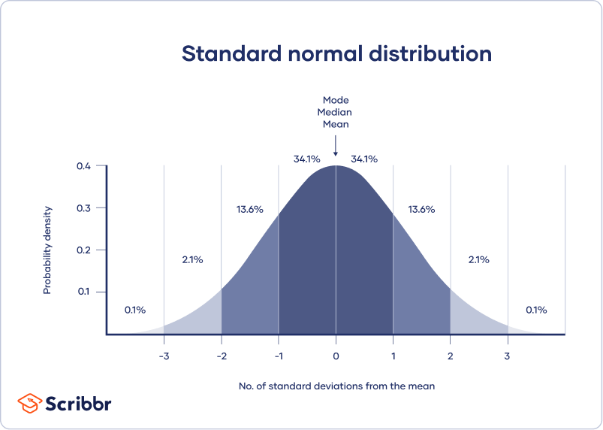

Slide 17
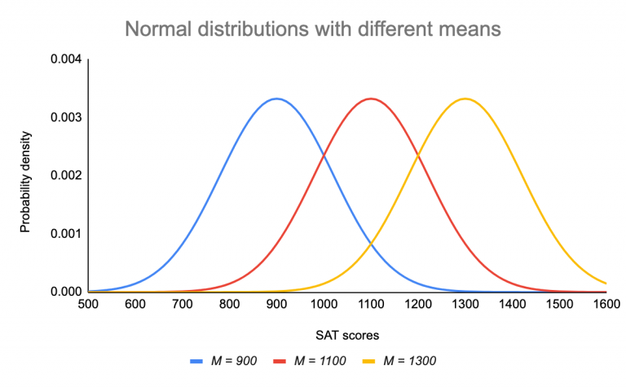
The mean is the location parameter while the standard deviation is the scale parameter.
The mean determines where the peak of the curve is centered. Increasing the mean moves the curve right, while decreasing it moves the curve left.

Slide 18
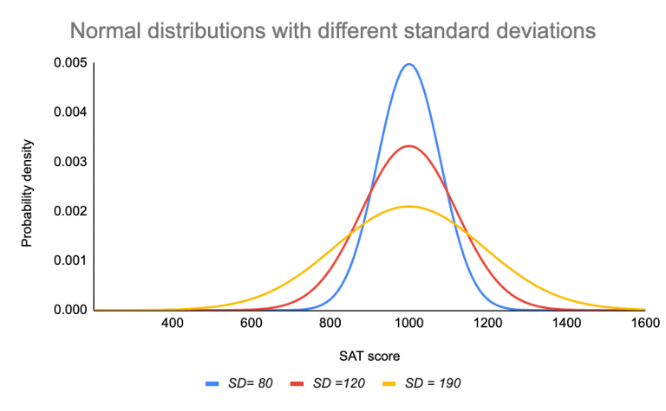
The standard deviation stretches or squeezes the curve. A small standard deviation results in a narrow curve, while a large standard deviation leads to a wide curve.

Slide 19
Question
?

